Slide 1
PREDICTION OF WIND POWER BASED ON WEATHER CONDITIONS
By
Lokesh S
Manjunath B Kanavalli
Manasa A
Naveen Reddy C S

Slide 2
INTRODUCTION
Wind energy plays an increasing role in the supply of energy world-wide.
The energy output of a wind farm is highly dependent on the wind conditions present at its site.
Wind speed/power has received increasing attention around the earth due to its renewable nature as well as environmental friendliness.
With the global installed wind power capacity rapidly increasing, the wind industry is growing into a large-scale business.

Slide 3
PURPOSE
If the output can be predicted more accurately, energy suppliers can coordinate the collaborative production of different energy sources more efficiently to avoid costly overproduction
PROPOSED SOLUTION
Estimation: Given weather conditions like wind speed, wind direction is used for determining the energy power prediction.

Slide 4
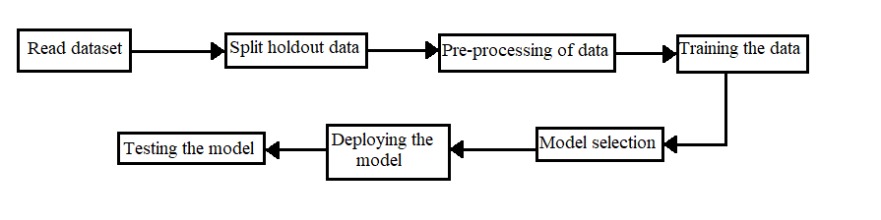
BLOCK DIAGRAM

Slide 5
METHODOLOGY
The METHODOLOGY is used here is Auto AI model using IBM Cloud and User Interface is created by NODE-RED using IBM Cloud.
AUTO AI MODEL STEPS
1. Set Up
2. Compose Pipeline
3. Extract needed parameter values from AutoAI run metadata
4. Create data frame from dataset in Cloud Object Storage
5. Pre-processing Data
6. Split data into Training and Holdout sets
7. Generate features via Feature Engineering pipeline
8. Additional setup: Define a function that returns a scorer for the target's positive label
9. Fit pipeline, predict on Holdout set, calculate score, perform cross-validation

Slide 6
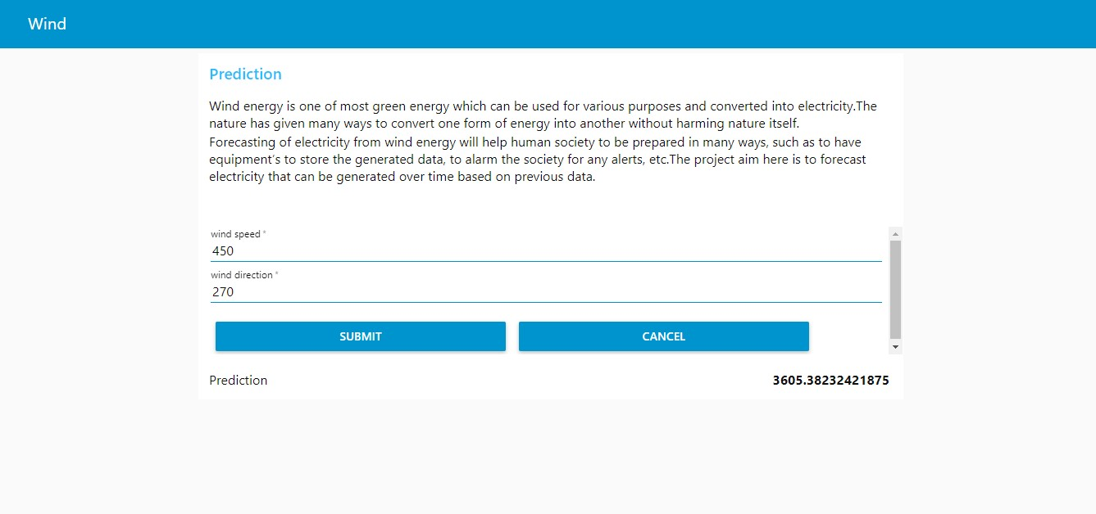
RESULTS
The Results which are obtained by UI is given by

Slide 7
CONCLUSION
This project is built for prediction of the wind power based on weather conditions like wind speed and wind direction. The estimation model can be done using Artificial Neural Networks(ANN) .

Slide 8
THANK YOU

